Slide 1
MIKE 11
Model Stability, Tips & Tricks

Slide 2
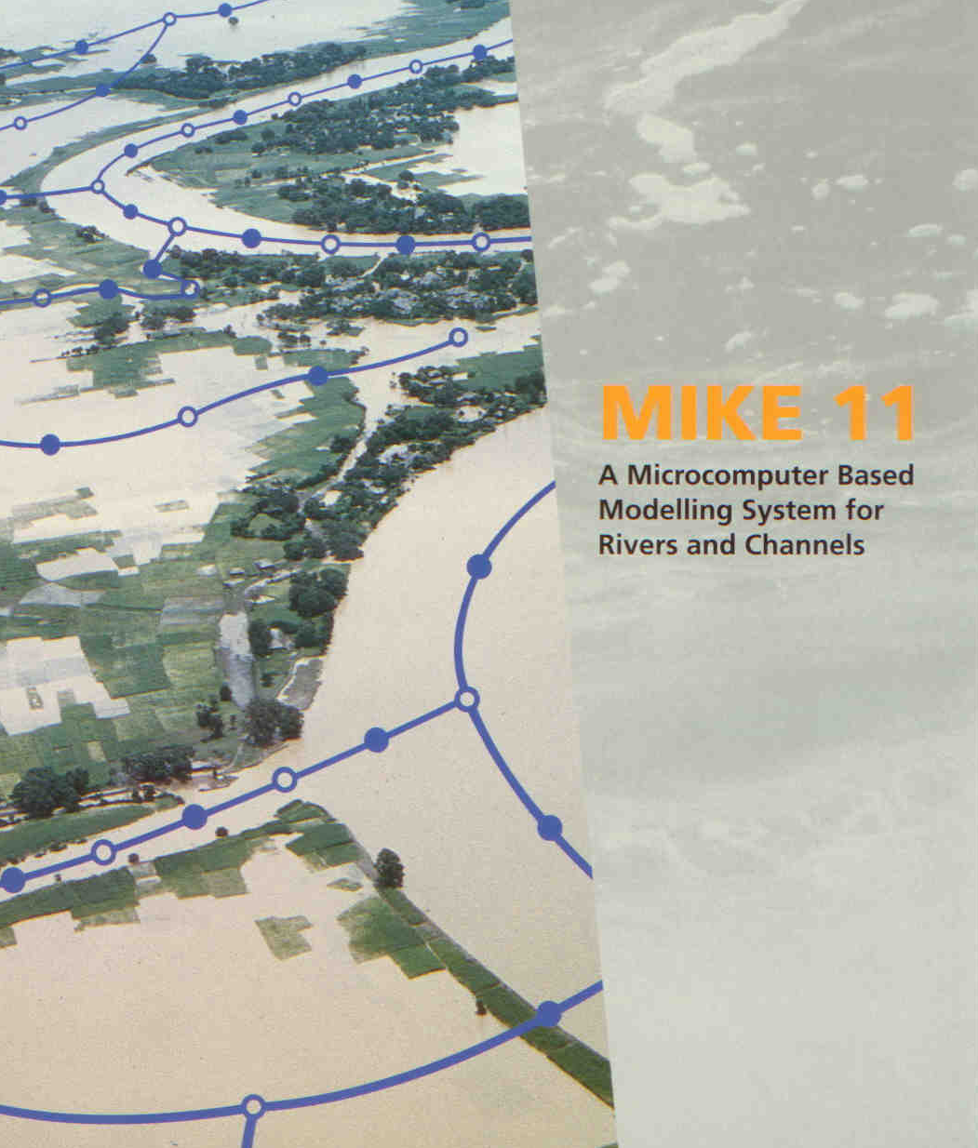
STABILITY, TIPS & TRICKS
Model Stability, Tips and Tricks

Slide 3
STABILITY, TIPS & TRICKS
Stability Criteria (Courant Number)
The Courant Number (Cr) describes the Relationship between:
the Speed of Physical Disturbances in the System, and
the Speed at which Disturbances Travel in the Numerical Model
Courant Number:
Physical Propagation Speed
Max Numerical Propagation Speed

Slide 4
STABILITY, TIPS & TRICKS
Spatial and Temporal Constraints
Space Step (Δx)
Δx needs to be small enough to resolve changes in channel
width and rapid changes in the water surface profile
Small Δx can result in high Courant numbers
Small Δx normally corresponds to a small Δt
Time Step (Δt)
Requirement for a small Δt can be symptomatic of poor
model schematisation
Selection of Δt should be based on time varying characteristics
of the system (ie. tidal models, Δt < 15 mins)
Very rapidly changing flow (ie dambreak) will require a small Δt
The Courant Criteria can be used to set an Upper Bound on the Time Step (Δt) based on a given Spatial Resolution (Δx)

Slide 5
STABILITY, TIPS & TRICKS
Enhancing Stability
Increases Simulation Time
To increase the stability of the system
Decrease the Time Step (Δt)
Increase the Space Step (Δx)
(particularly near structures)
Use different Wave Approximation
(ie. Kinematic Wave for Steep Reaches)
Use Weirs/Links Channels at Confluences
with Different Invert Levels
Increase Number of Iterations per Time Step
Increase Number of Iterations at Structures
Change Default Values (Delta & Zeta Min)
Recalculate levels of processed data of cross-sections
Decreases Simulation Time

Slide 6
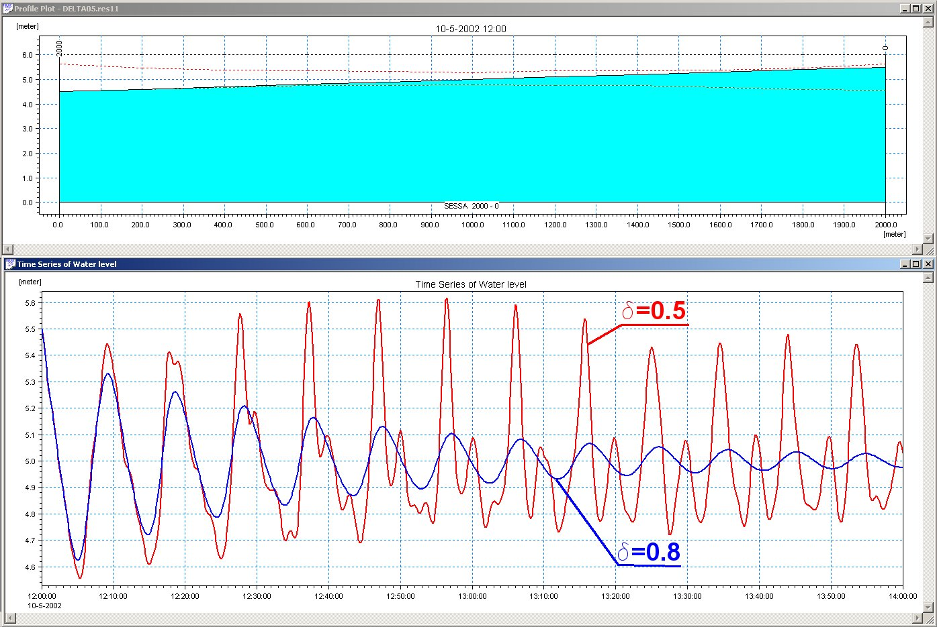
STABILITY, TIPS & TRICKS
Default Values (Delta)
d = 0.5, FD Scheme is Fully Centred
Equal Emphasis on t ^{n} and t ^{n+1}
d > 0.5, Stabilising Effect but also Dissipative
d = 1.0, FD Scheme is Forward Centred
All Emphasis on t ^{n+1}
Model Type | Delta Range
Tidal | 0.50 – 0.60
Upland River | 0.50 – 0.70
Large River | 0.50 – 0.80
Steady State | 0.50 – 1.00

Slide 7

STABILITY, TIPS & TRICKS
Default Values (Zeta Min)
ξ_{min} Minimum value of the
sum of calculated head loss
factors (at structures)
ΔH = ξ(V²/2g),
where: ξ = Σ(ξ_{in}, ξ_{out}, _{bend}…)
Increasing ξ_{min}
Stabilises structure solution,
but also has the effect of
introducing higher head
losses at structures
Structures with a Very Small
Head Loss Can Cause Instability
in the Model – Consider Removing

Slide 8
STABILITY, TIPS & TRICKS
Tips for Structures
Broad Crested Weirs:
Insert Wedge in Base so that Flow can
Commence Gradually
Long Culverts:
Use Closed Sections instead of Structure
to account for Friction effects
Use Small Dx to develop water surface
profile inside long culvert
Tabular Data:
If changes are made to Sections
U/S or D/S of a Structure, remember
to Recalculate Q/h relations
Make sure Q/h relations are
Monotonically increasing
Add more levels to the Q/h relations when necessary
Closed cross sections

Slide 9
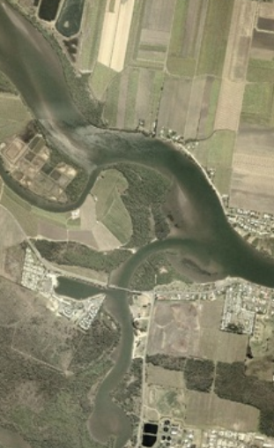
STABILITY, TIPS & TRICKS
Tips at Confluences
Important to Define Cross-Section Changes at Confluences:
MIKE11 will copy (extrapolate) nearest Cross-Section to
Branch End if no Cross-Section Exists
In Longitudinal Profiles (MIKE View) Branch Ends with
no Cross-Section will be assigned Invert Level of Zero
MIKE11 will interpolate Cross-Section at Junctions
if no Cross-Section Exists
Preferable to Copy/Move to prevent Unrealistic
Extrapolations or Interpolations
Take Care When Graphically Connecting Branches:
A Junction forces a H-point in the Scheme
Graphical Connection Tool snaps to Cross-Sections
and Digitised Points (very small Δx can occur)

Slide 10
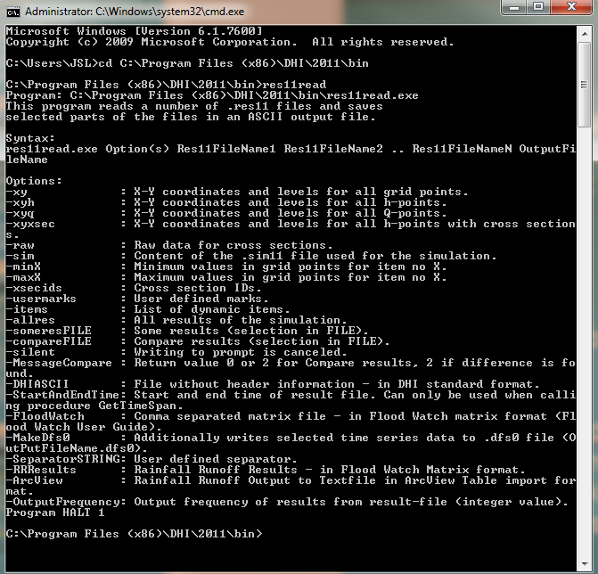
ADDITIONAL FEATURES
res11read programme
Small utility to read and export MIKE 11 res11 files to text format.
Found under C:\Program Files (x86)\DHI\20xx\bin\
res11read.exe
More info:
- Appendix B, MIKE 11 User Manual
Tips and Tricks page on DHI website
  Res11read.exe’ 64-bit since release 2012: Extraction possible from large result-files (> 1GB)

Slide 11
GETTING HELP IN MIKE 11
Help Menu: Access the Help from any editors by pressing the F1 Key
Manuals:
  MIKE 11 User Manual
  MIKE 11 Reference Manual
  MIKE Zero Manuals
For an easy access to all manuals available, open the Documentation Index
How? Start > Programs > MIKE by DHI 20xx > MIKE Zero > Documentation > MIKE 11 Documentation Index

Slide 12
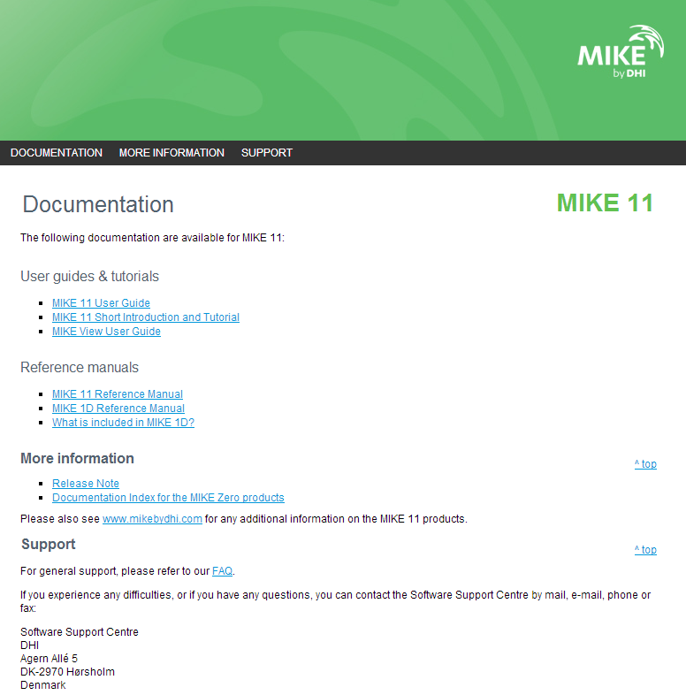
MIKE 11 DOCUMENTATION INDEX

Slide 13


MORE WAYS TO FIND HELP
Install and check the examples that come with each programme
FAQ Page on DHI’s website
http://faq.dhigroup.com
Tips and Tricks Page on DHI’s website
http://tips.dhigroup.com

